Slide 1
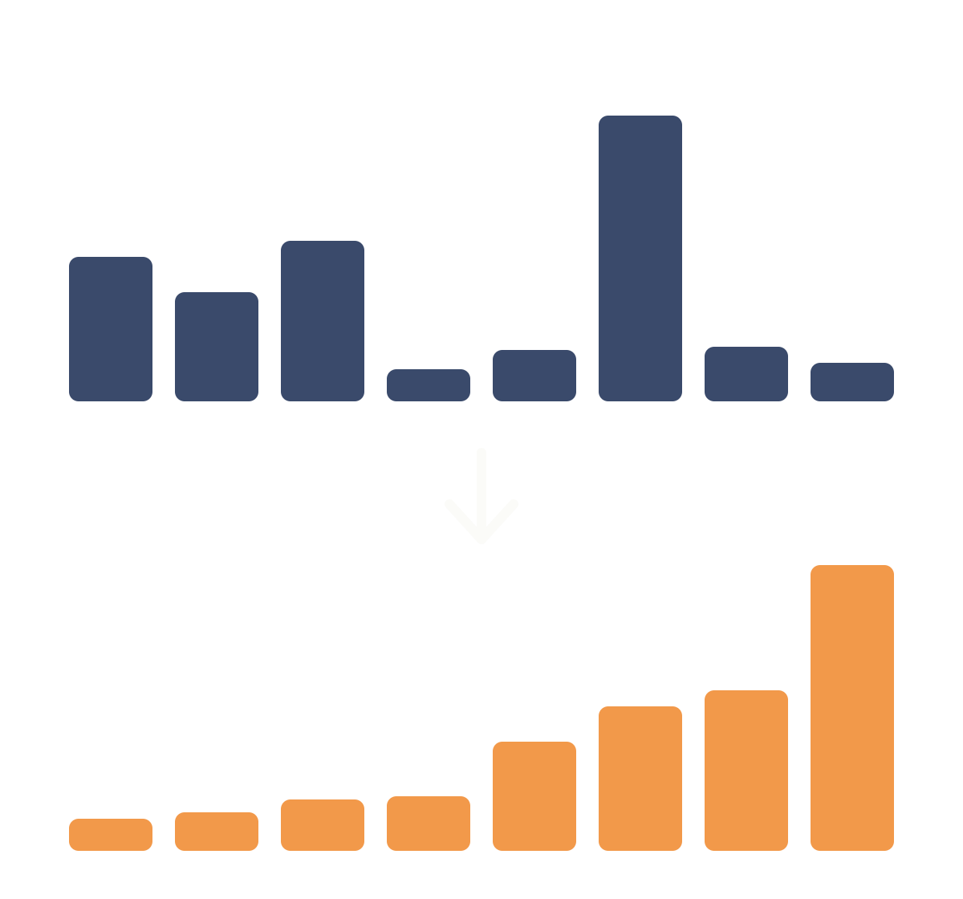
Merge Sort
DESIGN AND ANALYSIS OF ALGORITHMS
Divide the array, sort each half, then merge in O(n log n)
Notes:
Welcome. This presentation covers merge sort, a divide-and-conquer sorting algorithm from the Design and Analysis of Algorithms course. It was generated using Claude.

Slide 2
What is merge sort?
Divide and conquer
Stable
Predictable
Splits the problem into halves, solves each half, then combines the results.
Equal elements keep their original order after sorting.
Runs in O(n log n) time in the best, average and worst case.
Input: an array of n comparable items. Output: the same items in ascending order. Invented by John von Neumann in 1945.
Generated using Claude · Merge Sort · DAA
2
Notes:
Merge sort is a stable, comparison-based, divide-and-conquer sort. Its running time is the same for every input order, which makes it predictable. It was proposed by John von Neumann in 1945.

Slide 3
Divide, conquer, combine
01
02
03
Divide
Conquer
Combine
Split the array into a left half and a right half at the middle index.
Sort each half by calling merge sort on it recursively.
Merge the two sorted halves into one sorted array.
Base case: an array with 0 or 1 elements is already sorted, so the recursion stops.
Generated using Claude · Merge Sort · DAA
3
Notes:
The three phases are divide, conquer and combine. All the real work happens in the combine step, which merges two sorted halves. A single element is trivially sorted, so it is the base case.

Slide 4
Example: splitting the array
Whole array
38
27
43
3
9
82
10
5
3 levels
Halves
38
27
43
3
9
82
10
5
Each split halves the array: 8, 4, 2, then 1. That is log₂ 8 = 3 levels of splitting.
Quarters
38
27
43
3
9
82
10
5
Single items
38
27
43
3
9
82
10
5
Generated using Claude · Merge Sort · DAA
4
Notes:
We use the array 38, 27, 43, 3, 9, 82, 10, 5. It is split in half again and again until every piece holds a single element. Eight elements need three levels of splitting.

Slide 5
Example: merging back up
Single items
38
27
43
3
9
82
10
5
O(n) per level
Merge pairs
27
38
3
43
9
82
5
10
Every level merges all 8 elements once, so the work at each level is proportional to n.
Merge fours
3
27
38
43
5
9
10
82
Merge all
3
5
9
10
27
38
43
82
Generated using Claude · Merge Sort · DAA
5
Notes:
Now the sorted pieces are merged back. Pairs become sorted pairs, pairs become sorted groups of four, and the two fours merge into the final sorted array. Orange cells are sorted runs.

Slide 6
Merge trace: the final merge
Left = [3, 27, 38, 43] and Right = [5, 9, 10, 82]. Compare the two front elements, copy the smaller one.
Step | Compare | Take | Output so far
1 | 3 vs 5 | 3 (left) | [3]
2 | 27 vs 5 | 5 (right) | [3, 5]
3 | 27 vs 9 | 9 (right) | [3, 5, 9]
4 | 27 vs 10 | 10 (right) | [3, 5, 9, 10]
5 | 27 vs 82 | 27 (left) | [3, 5, 9, 10, 27]
6 | 38 vs 82 | 38 (left) | [3, 5, 9, 10, 27, 38]
7 | 43 vs 82 | 43 (left) | [3, 5, 9, 10, 27, 38, 43]
8 | Left is empty | 82 (copy the rest) | [3, 5, 9, 10, 27, 38, 43, 82]
Generated using Claude · Merge Sort · DAA
6
Notes:
Two pointers walk along the two sorted halves. At each step the smaller front element is copied to the output. When one half runs out, the rest of the other half is copied. Eight elements need at most seven comparisons here.

Slide 7
Sorted result
3
5
9
10
27
38
43
82
3
8
24
Levels
Work per level
Total effort
log₂ 8 = 3 rounds of splitting and merging.
Each level merges all n = 8 elements once.
About n log₂ n = 8 × 3 = 24 element moves.
Generated using Claude · Merge Sort · DAA
7
Notes:
The array is now sorted: 3, 5, 9, 10, 27, 38, 43, 82. Three levels, each doing about n work, gives roughly n log n steps in total.

Slide 8
Time and space complexity
Measure | Cost | Why
Best case | O(n log n) | It still splits and merges at every level
Average case | O(n log n) | log n levels, about n work per level
Worst case | O(n log n) | The input order never changes the split
Extra space | O(n) | Temporary arrays hold the halves while merging
Recurrence: T(n) = 2T(n/2) + O(n), which solves to O(n log n).
Generated using Claude · Merge Sort · DAA
8
Notes:
Two half-size subproblems plus a linear merge give the recurrence T of n equals 2 T of n over 2 plus order n. By the master theorem or a recursion tree, that is order n log n. The temporary arrays make the extra space order n.

Slide 9
Pseudocode
mid
MERGE-SORT(A, lo, hi):
Splits the range into two halves.
if lo ≥ hi: return
mid ← ⌊(lo + hi) / 2⌋
MERGE
MERGE-SORT(A, lo, mid)
MERGE-SORT(A, mid + 1, hi)
Copies the halves, then takes the smaller front item each time.
MERGE(A, lo, mid, hi)
MERGE(A, lo, mid, hi):
≤ test
L ← copy of A[lo..mid]; R ← copy of A[mid+1..hi]
i ← 0; j ← 0; k ← lo
Taking from the left on a tie keeps the sort stable.
while i < |L| and j < |R|:
if L[i] ≤ R[j]: A[k++] ← L[i++]
else: A[k++] ← R[j++]
copy any leftover items of L or R into A
Generated using Claude · Merge Sort · DAA
9
Notes:
MERGE-SORT recurses on the two halves, then calls MERGE. MERGE copies each half into a temporary array and walks both with two indices, writing the smaller item back into A. On equal items it takes the left one, which is what makes the sort stable.

Slide 10
Merge sort vs quick sort
Aspect | Merge sort | Quick sort
Strategy | Split at the middle, merge after | Partition around a pivot, then recurse
Worst case | O(n log n) | O(n²)
Extra space | O(n) | O(log n)
Stable | Yes | No
Best for | Linked lists and external sorting | In-memory arrays
Both are divide and conquer, and both average O(n log n).
Generated using Claude · Merge Sort · DAA
10
Notes:
Merge sort does the easy split and the hard merge. Quick sort does the hard partition and the easy join. Merge sort guarantees n log n and stability at the cost of extra memory; quick sort is usually faster in practice on arrays but can degrade to n squared.

Slide 11
Key takeaways
Merge sort splits the array in half, sorts each half, then merges them.
Merging two sorted halves takes O(n) time.
T(n) = 2T(n/2) + O(n) gives O(n log n) in every case.
It needs O(n) extra space and is stable.
Generated using Claude
11
Notes:
To recap: divide, conquer, combine. The merge step does the work, there are log n levels, and the total cost is n log n. This presentation was generated using Claude.

